Slide 1

Sequence modelling RNN, LSTM, GRU
Hongtu Zhu
Bios 7xx: Deep Learning Methods for Biomedical Applications with Pytorch

Slide 2
Lecture Plan
A bit more about neural networks (10 mins) Language modeling + RNNs
2. A new NLP task: Language Modeling (20 mins)
This is the most important concept in the class! It leads to GPT-3 and ChatGPT!
motivates
3. A new family of neural networks: Recurrent Neural Networks (RNNs) (25 mins)
Important and used in one assignment, but not the only way to build LMs
4. Problems with RNNs (15 mins)
5. Recap on RNNs/LMs (10 mins) Reminders:
Assignment 3
In Assignment 4, out today, you build a neural dependency parser using PyTorch

Slide 3
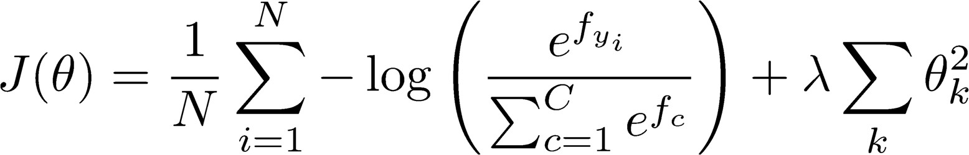
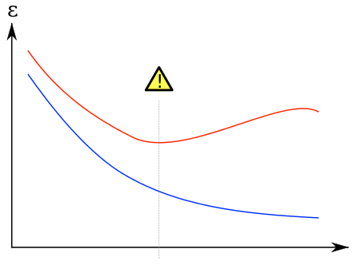
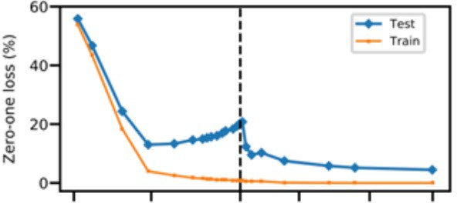
We have models with many parameters! Regularization!
A full loss function includes regularization over all parameters 𝜃, e.g., L2 regularization:
Classic view: Regularization works to prevent overfitting when we have a lot of features (or later a very powerful/deep model, etc.)
Now: Regularization produces models that generalize well when we have a “big” model
We do not care that our models overfit on the training data, even though they are hugely overfit
error
overfitting
Test error
Training error
0
model “power”

Slide 4
Dropout (Srivastava, Hinton, Krizhevsky, Sutskever, & Salakhutdinov 2012/JMLR 2014)
Preventing Feature Co-adaptation = Good Regularization Method! Use it everywhere!
Training time: at each instance of evaluation (in online SGD-training), randomly set
~50% (p%) of the inputs to each neuron to 0
Test time: halve the model weights (now twice as many)
Except usually only drop first layer inputs a little (~15%) or not at all
This prevents feature co-adaptation: A feature cannot only be useful in the presence of particular other features
In a single layer: A kind of middle-ground between Naïve Bayes (where all feature weights are set independently) and logistic regression models (where weights are set in the context of all others)
Can be thought of as a form of model bagging (i.e., like an ensemble model)
Nowadays usually thought of as strong, feature-dependent regularizer [Wager, Wang, & Liang 2013]

Slide 5
Dropout (Srivastava, Hinton, Krizhevsky, Sutskever, & Salakhutdinov 2012/JMLR 2014)
During training
For each data point each time:
Randomly set input to 0 with probability 𝑝 “dropout ratio” (often p = 0.5 except p – 0.15 for input layer) via dropout mask
During testing
Multiply all weights by 1 − 𝑝
No other dropout
Train 1 Train 2 Test
𝑥
𝑥 𝑥
#
𝑤!
𝑤"
𝑤#
𝑤$
𝑏
# #
𝑤!
𝑤"
𝑤#
𝑤$
𝑏
𝑤!
𝑤"
𝑤#
𝑤$
𝑏
0
𝑥$
𝑥" 0
𝑥$
𝑥"
𝑥₊
𝑥"
0
1
𝑦 = 𝑤₁𝑥₁ + 𝑤₃𝑥₃ + 𝑏
1
𝑦 = 𝑤#𝑥# +
𝑤$𝑥$ + 𝑤%𝑥%
1
𝑦 = (1 − 𝑝)(𝑤#𝑥# +
𝑤$𝑥$ + 𝑤%𝑥% + 𝑤&𝑥&)

Slide 6
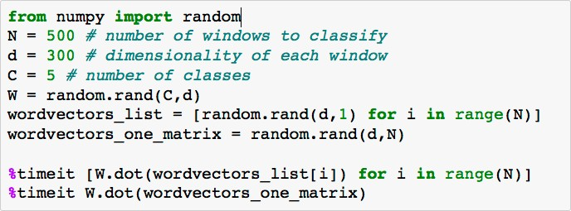
“Vectorization”
E.g., looping over word vectors versus concatenating them all into one large matrix and then multiplying the softmax weights with that matrix:
for loop: 1000 loops, best of 3: 639 µs per loop Using single a C x N matrix: 10000 loops, best of 3: 53.8 µs per loop
Matrices are awesome!!! Always try to use vectors and matrices rather than for loops!
The speed gain goes from 1 to 2 orders of magnitude with GPUs!

Slide 7
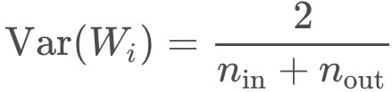
Parameter Initialization
You normally must initialize weights to small random values (i.e., not zero matrices!)
To avoid symmetries that prevent learning/specialization
Initialize hidden layer biases to 0 and output (or reconstruction) biases to optimal value if weights were 0 (e.g., mean target or inverse sigmoid of mean target)
Initialize all other weights ~ Uniform(–r, r), with r chosen so numbers get neither too big or too small [later, the need for this is removed with use of layer normalization]
Xavier initialization has variance inversely proportional to fan-in n_{in} (previous layer size) and fan-out n_{out} (next layer size):

Slide 8
Optimizers
Usually, plain SGD will work just fine!
However, getting good results will often require hand-tuning the learning rate
E.g., start it higher and halve it every k epochs (passes through full data, shuffled or sampled)
For more complex nets, or to avoid worry, try more sophisticated “adaptive” optimizers that scale the adjustment to individual parameters by an accumulated gradient
These models give differential per-parameter learning rates
Adagrad � Simplest member of family, but tends to “stall early”
RMSprop
Adam � A fairly good, safe place to begin in many cases
AdamW
NAdamW � Can be better with word vectors (W) and for speed (Nesterov acceleration)
…
Start them with an initial learning rate, around 0.001 � Many have other hyperparameters

Slide 9
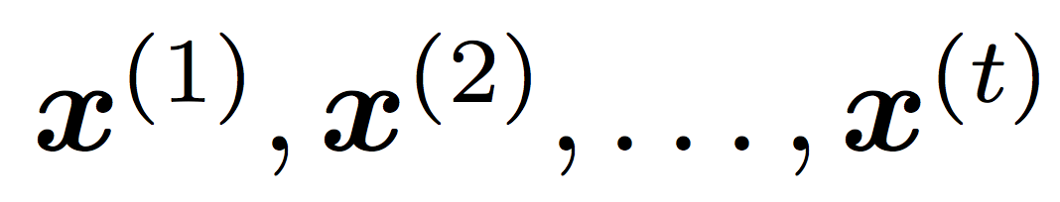
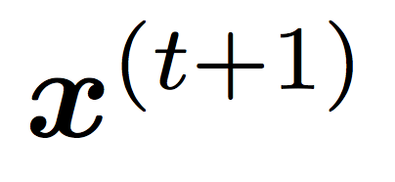
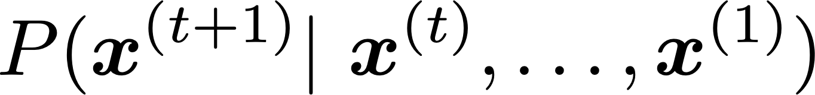
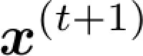
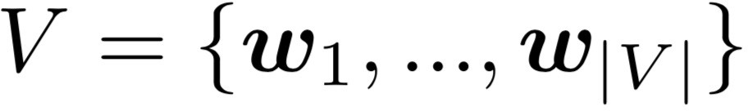
2. Language Modeling
Language Modeling is the task of predicting what word comes next
books
the students opened their
laptops
exams
minds
More formally: given a sequence of words
compute the probability distribution of the next word
,
:
where can be any word in the vocabulary
A system that does this is called a Language Model

Slide 10
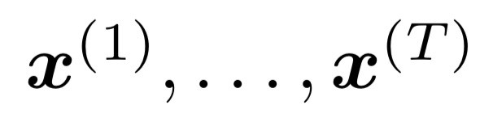
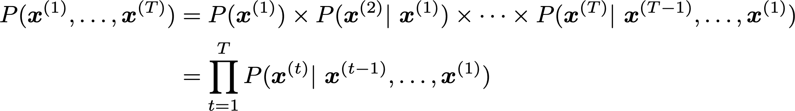
Language Modeling
You can also think of a Language Model as a system that assigns a probability to a piece of text
For example, if we have some text , then the probability of this text (according to the Language Model) is:
This is what our LM provides

Slide 11
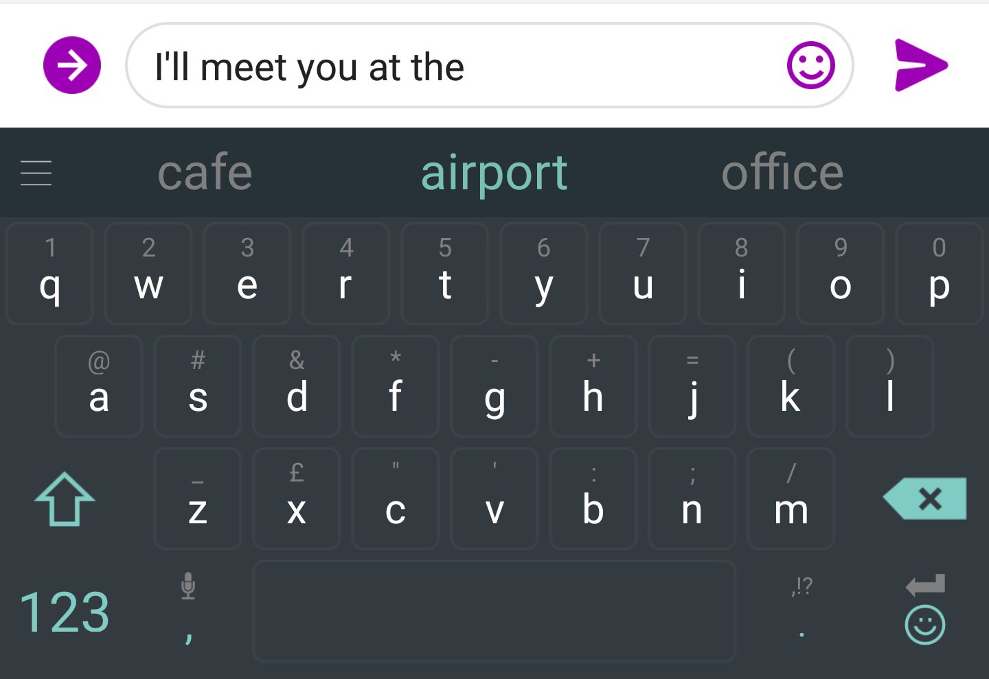
You use Language Models every day!

Slide 12

You use Language Models every day!

Slide 13
n-gram Language Models
the students opened their
Question: How to learn a Language Model?
Answer (pre- Deep Learning): learn an n-gram Language Model!
Definition: An n-gram is a chunk of n consecutive words.
unigrams: “the”, “students”, “opened”, ”their”
bigrams: “the students”, “students opened”, “opened their”
trigrams: “the students opened”, “students opened their”
four-grams: “the students opened their”
Idea: Collect statistics about how frequent different n-grams are and use these to predict next word.

Slide 14
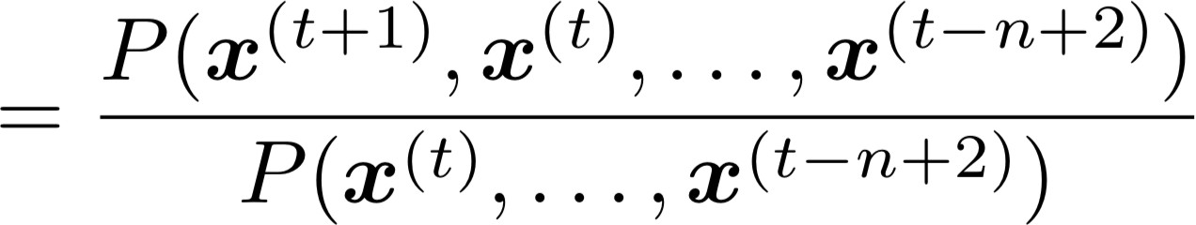
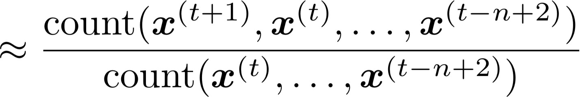
n-gram Language Models
First we make a Markov assumption: 𝑥^{(&'!)} depends only on the preceding n-1 words
n-1 words
(assumption)
prob of a n-gram
(definition of conditional prob)
prob of a (n-1)-gram
Question: How do we get these n-gram and (n-1)-gram probabilities?
Answer: By counting them in some large corpus of text!
(statistical approximation)

Slide 15
n-gram Language Models: Example
Suppose we are learning a 4-gram Language Model.
as the proctor started the clock, the students opened their
discard
condition on this
For example, suppose that in the corpus:
“students opened their” occurred 1000 times
“students opened their books” occurred 400 times
➔ P(books | students opened their) = 0.4
“students opened their exams” occurred 100 times
➔ P(exams | students opened their) = 0.1
Should we have discarded the “proctor” context?

Slide 16
Sparsity Problems with n-gram Language Models
Sparsity Problem 1
Problem: What if “students opened their 𝑤” never occurred in data? Then 𝑤 has probability 0!
(Partial) Solution: Add small 𝛿 to the count for every 𝑤 ∈ 𝑉. This is called smoothing.
Sparsity Problem 2
Problem: What if “students opened their” never occurred in data? Then we can’t calculate probability for any 𝑤!
(Partial) Solution: Just condition on “opened their” instead.
This is called backoff.
Note: Increasing n makes sparsity problems worse.
Typically, we can’t have n bigger than 5.

Slide 17
Storage Problems with n-gram Language Models
Storage: Need to store count for all n-grams you saw in the corpus.
Increasing n or increasing corpus increases model size!

Slide 18
n-gram Language Models in practice
You can build a simple trigram Language Model over a
1.7 million word corpus (Reuters) in a few seconds on your laptop*
Business and financial news
today the
get probability distribution
company bank price italian emirate
0.153
0.153
Sparsity problem: not much granularity in the probability distribution
0.077
0.039
0.039
…
Otherwise, seems reasonable!
* Try for yourself: https://nlpforhackers.io/language-models/

Slide 19
Generating text with a n-gram Language Model
You can also use a Language Model to generate text
today the
condition on this
get probability distribution
company | 0.153
bank | 0.153
price | 0.077
italian | 0.039
emirate | 0.039 …
sample

Slide 20
Generating text with a n-gram Language Model
You can also use a Language Model to generate text
today the price
condition on this
get probability distribution
of | 0.308 | sample
for | 0.050
it | 0.046
to | 0.046
is | 0.031 …

Slide 21
Generating text with a n-gram Language Model
You can also use a Language Model to generate text
today the price of
condition on this
get probability distribution
the 18
oil
its gold
0.072
0.043
0.043
0.036
0.018
…
sample

Slide 22
Generating text with a n-gram Language Model
You can also use a Language Model to generate text
today the price of gold per ton , while production of shoe lasts and shoe industry , the bank intervened just after it considered and rejected an imf demand to rebuild depleted european stocks , sept 30 end primary 76 cts a share .
Surprisingly grammatical!
…but incoherent. We need to consider more than three words at a time if we want to model language well.
But increasing n worsens sparsity problem, and increases model size…

Slide 23
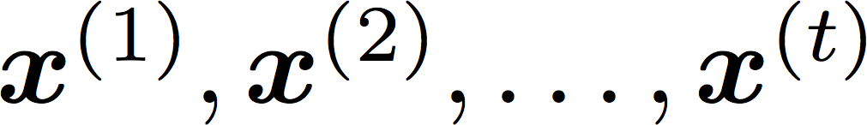

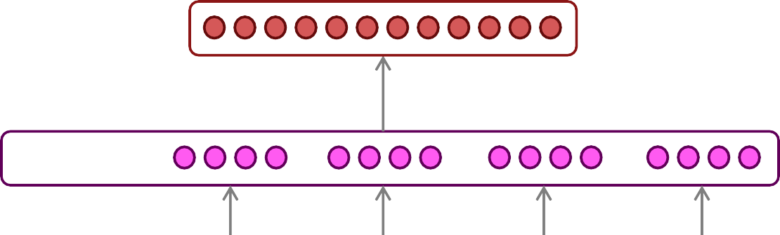




How to build a neural language model?
Recall the Language Modeling task:
Input: sequence of words
Output: prob. dist. of the next word
How about a window-based neural model?
We saw this applied to Named Entity Recognition in Lecture 2:
LOCATION
museums
in
Paris
are amazing

Slide 24
A fixed-window neural Language Model
as
the
proctor started the
clock
the students opened
fixed window
their
discard

Slide 25

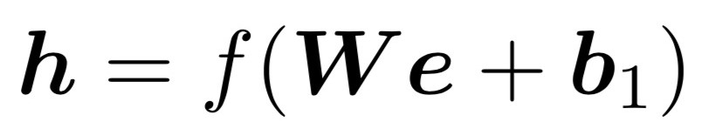




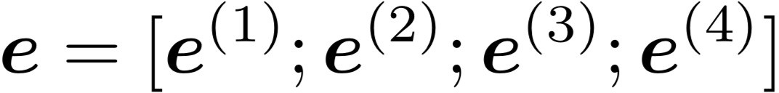


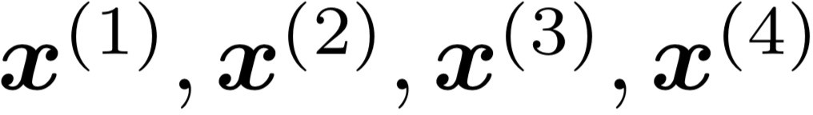
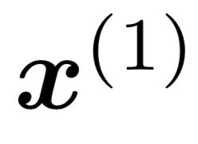
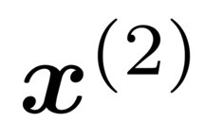
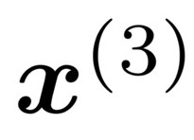
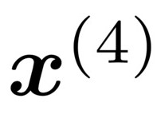
A fixed-window neural Language Model
books
laptops
output distribution
a
zoo
hidden layer
concatenated word embeddings
words / one-hot vectors
the students
opened
their

Slide 26




A fixed-window neural Language Model
Approximately: Y. Bengio, et al. (2000/2003): A Neural Probabilistic Language Model
Improvements over n-gram LM:
No sparsity problem
Don’t need to store all observed n-grams
books
laptops
a
zoo
Remaining problems:
Fixed window is too small
Enlarging window enlarges 𝑊
Window can never be large enough!
𝑥^{(!)} and 𝑥^{(")} are multiplied by completely different weights in 𝑊. No symmetry in how the inputs are processed.
We need a neural architecture that can process any length input
the students
opened
their

Slide 27
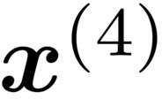
3. Recurrent Neural Networks (RNN)
A family of neural architectures
Core idea: Apply the same weights 𝑊 repeatedly
outputs (optional)
…
hidden states
…
input sequence (any length)
…

Slide 28
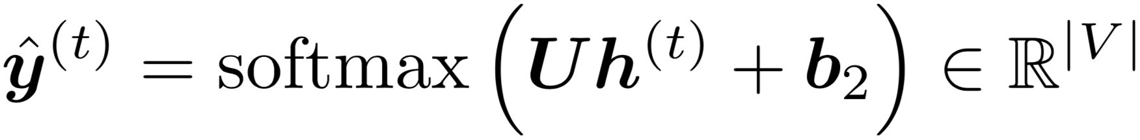
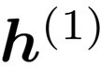
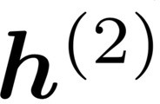
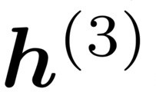

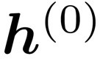
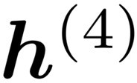



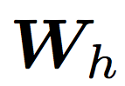

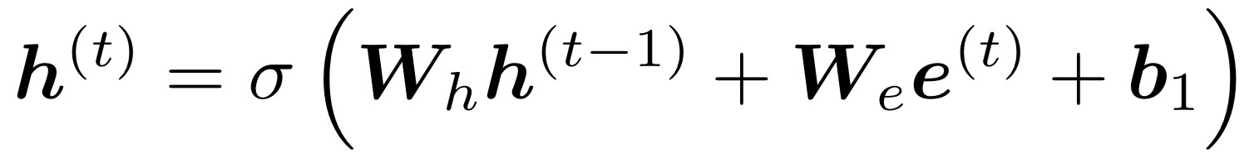
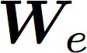




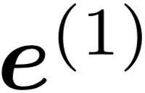
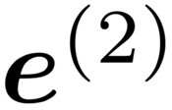
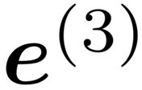
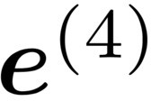
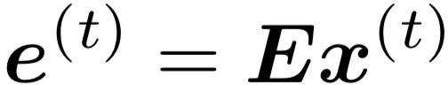
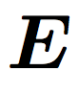
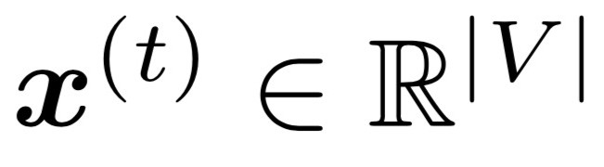
A Simple RNN Language Model
books
laptops
output distribution
a
zoo
hidden states
is the initial hidden state
word embeddings
the students
opened
their
words / one-hot vectors
Note: this input sequence could be much longer now!

Slide 29
RNN Language Models
books
laptops
RNN Advantages:
Can process any length input
Computation for step t can (in
theory) use information from many steps back
Model size doesn’t increase for longer input context
Same weights applied on every
timestep, so there is symmetry in how inputs are processed.
a
zoo
RNN Disadvantages:
Recurrent computation is slow
In practice, difficult to access information from many steps back
More on these later
the students
opened
their

Slide 30
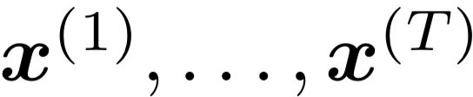
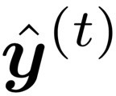
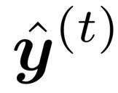
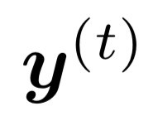
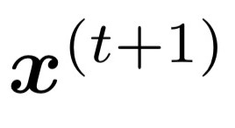
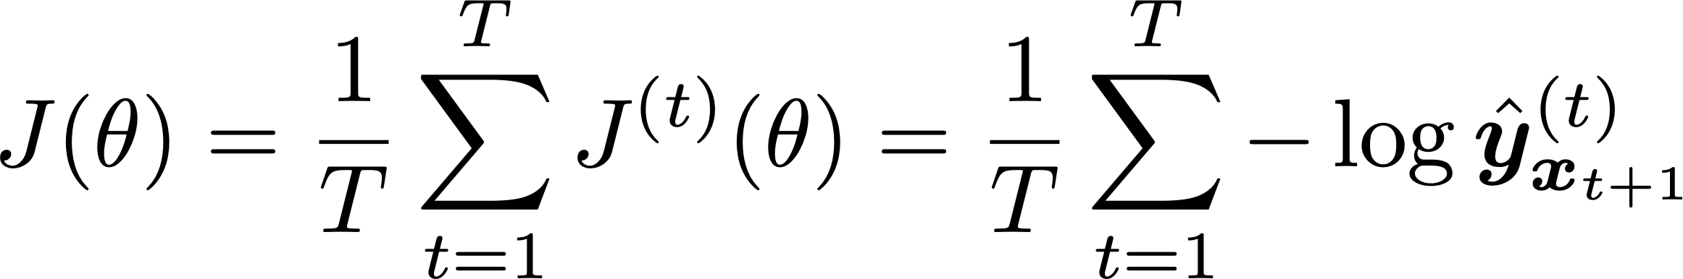
Training an RNN Language Model
Get a big corpus of text which is a sequence of words
Feed into RNN-LM; compute output distribution
for every step t.
i.e., predict probability dist of every word, given words so far
Loss function on step t is cross-entropy between predicted probability distribution , and the true next word (one-hot for ):
Average this to get overall loss for entire training set:

Slide 31
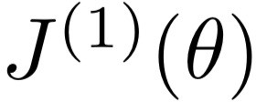
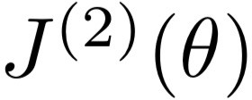
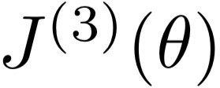











Training an RNN Language Model
= negative log prob of “students”
Loss
Predicted prob dists
…
Corpus
the
students
opened
their
exams
…

Slide 32

Training an RNN Language Model
= negative log prob of “opened”
Loss
Predicted prob dists
…
Corpus
the
students
opened
their
exams
…

Slide 33
Training an RNN Language Model
= negative log prob of “their”
Loss
Predicted prob dists
…
Corpus
the
students
opened
their
exams
…

Slide 34
Training an RNN Language Model
= negative log prob of “exams”
Loss
Predicted prob dists
…
Corpus
the
students
opened
their
exams
…

Slide 35

Training an RNN Language Model
“Teacher forcing”
Loss
+
+
+
+ … =
Predicted prob dists
…
Corpus
the
students
opened
their
exams
…

Slide 36


Training a RNN Language Model
However: Computing loss and gradients across entire corpus too expensive (memory-wise)!
at once is
In practice, consider as a sentence (or a document)
Recall: Stochastic Gradient Descent allows us to compute loss and gradients for small chunk of data, and update.
Compute loss for a sentence (actually, a batch of sentences), compute gradients and update weights. Repeat on a new batch of sentences.

Slide 37








Backpropagation for RNNs
…
…
Question: What’s the derivative of
w.r.t. the repeated weight matrix ?
“The gradient w.r.t. a repeated weight is the sum of the gradient
w.r.t. each time it appears”
Answer:
Why?

Slide 38



Multivariable Chain Rule
Source:
https://www.khanacademy.org/math/multivariable-calculus/multivariable-derivatives/differentiating-vector-valued-functions/a/multivariable-chain-rule-simple-version

Slide 39



Training the parameters of RNNs: Backpropagation for RNNs
In practice, often “truncated” after ~20 timesteps for training efficiency reasons
…
…
equals
equals
equals
equals
equals
Apply the multivariable chain rule:
= 1
Question: How do we calculate this?
Answer: Backpropagate over timesteps
i = t, … ,0, summing gradients as you go. This algorithm is called “backpropagation through time” [Werbos, P.G., 1988, Neural Networks 1, and others]

Slide 40

Generating with an RNN Language Model (“Generating roll outs”)
Just like an n-gram Language Model, you can use a RNN Language Model to generate text by repeated sampling. Sampled output becomes next step’s input.
my
sample
favorite
sample
season
sample
is
sample
spring
sample
</s>
sample
<s>
my favorite
season
is
spring

Slide 41


Generating text with an RNN Language Model
Let’s have some fun!
You can train an RNN-LM on any kind of text, then generate text in that style.
RNN-LM trained on Obama speeches:
Source: https://medium.com/@samim/obama-rnn-machine-generated-political-speeches-c8abd18a2ea0

Slide 42


Generating text with an RNN Language Model
Let’s have some fun!
You can train an RNN-LM on any kind of text, then generate text in that style.
RNN-LM trained on Harry Potter:
Source: https://medium.com/deep-writing/harry-potter-written-by-artificial-intelligence-8a9431803da6

Slide 43


Generating text with an RNN Language Model
Let’s have some fun!
You can train an RNN-LM on any kind of text, then generate text in that style.
RNN-LM trained on recipes:
Source: https://gist.github.com/nylki/1efbaa36635956d35bcc

Slide 44


Generating text with a RNN Language Model
Let’s have some fun!
You can train a RNN-LM on any kind of text, then generate text in that style.
RNN-LM trained on paint color names:
This is an example of a character-level RNN-LM (predicts what character comes next)
44
Source: http://aiweirdness.com/post/160776374467/new-paint-colors-invented-by-neural-network

Slide 45



Evaluating Language Models
The standard evaluation metric for Language Models is perplexity.
Normalized by number of words
Inverse probability of corpus, according to Language Model
This is equal to the exponential of the cross-entropy loss
:
Lower perplexity is better!

Slide 46

RNNs greatly improved perplexity over what came before
n-gram model
Increasingly complex RNNs
Perplexity improves (lower is better)
Source: https://research.fb.com/building-an-efficient-neural-language-model-over-a-billion-words/

Slide 47


4. Problems with RNNs: Vanishing and Exploding Gradients

Slide 48

Vanishing gradient intuition
?

Slide 49


Vanishing gradient intuition
chain rule!

Slide 50


Vanishing gradient intuition
chain rule!

Slide 51


Vanishing gradient intuition
chain rule!

Slide 52
Vanishing gradient intuition
Vanishing gradient problem: When these are small, the gradient signal gets smaller and smaller as it backpropagates further
What happens if these are small?

Slide 53


















Vanishing gradient proof sketch (linear case)
Recall:
What if were the identity function, ?
(chain rule)
Consider the gradient of the loss on step , with respect to the hidden state on some previous step . Let
(chain rule)
(value of )
If W_{h} is “small”, then this term gets exponentially problematic as becomes large
Source: “On the difficulty of training recurrent neural networks”, Pascanu et al, 2013. http://proceedings.mlr.press/v28/pascanu13.pdf
(and supplemental materials), at http://proceedings.mlr.press/v28/pascanu13-supp.pdf
53

Slide 54









Vanishing gradient proof sketch (linear case)
sufficient but
What’s wrong with ?
not necessary
Consider if the eigenvalues of are all less than 1:
(eigenvectors) using the eigenvectors of
We can write
as a basis:
Approaches 0 as
grows, so gradient vanishes
What about nonlinear activations (i.e., what we use?)
Pretty much the same thing, except the proof requires
for some
dependent on dimensionality and
Source: “On the difficulty of training recurrent neural networks”, Pascanu et al, 2013. http://proceedings.mlr.press/v28/pascanu13.pdf
(and supplemental materials), at http://proceedings.mlr.press/v28/pascanu13-supp.pdf
54

Slide 55
Why is vanishing gradient a problem?
Gradient signal from far away is lost because it’s much smaller than gradient signal from close-by.
So, model weights are updated only with respect to near effects, not long-term effects.

Slide 56
Effect of vanishing gradient on RNN-LM
LM task: When she tried to print her tickets, she found that the printer was out of toner. She went to the stationery store to buy more toner. It was very overpriced. After installing the toner into the printer, she finally printed her
To learn from this training example, the RNN-LM needs to model the dependency between “tickets” on the 7th step and the target word “tickets” at the end.
But if the gradient is small, the model can’t learn this dependency
So, the model is unable to predict similar long-distance dependencies at test time

Slide 57

Why is exploding gradient a problem?
If the gradient becomes too big, then the SGD update step becomes too big:
learning rate
gradient
This can cause bad updates: we take too large a step and reach a weird and bad parameter configuration (with large loss)
You think you’ve found a hill to climb, but suddenly you’re in Iowa
In the worst case, this will result in Inf or NaN in your network (then you have to restart training from an earlier checkpoint)

Slide 58

Gradient clipping: solution for exploding gradient
Gradient clipping: if the norm of the gradient is greater than some threshold, scale it down before applying SGD update
Intuition: take a step in the same direction, but a smaller step
In practice, remembering to clip gradients is important, but exploding gradients are an easy problem to solve
58
Source: “On the difficulty of training recurrent neural networks”, Pascanu et al, 2013. http://proceedings.mlr.press/v28/pascanu13.pdf

Slide 59

How to fix the vanishing gradient problem?
The main problem is that it’s too difficult for the RNN to learn to preserve information over many timesteps.
In a vanilla RNN, the hidden state is constantly being rewritten
First off next time: How about an RNN with separate memory which is added to?
LSTMs
And then: Creating more direct and linear pass-through connections in model
Attention, residual connections, etc.

Slide 60
5. Recap
Language Model: A system that predicts the next word
Recurrent Neural Network: A family of neural networks that:
Take sequential input of any length
Apply the same weights on each step
Can optionally produce output on each step
Recurrent Neural Network ≠ Language Model
We’ve shown that RNNs are a great way to build a LM (despite some problems)
RNNs are also useful for much more!

Slide 61
Why should we care about Language Modeling?
Language Modeling is a benchmark task that helps us measure our progress on predicting language use
Language Modeling is a subcomponent of many NLP tasks, especially those involving generating text or estimating the probability of text:
Predictive typing
Speech recognition
Handwriting recognition
Spelling/grammar correction
Authorship identification
Machine translation
Summarization
Dialogue
etc.
Everything else in NLP has now been rebuilt upon Language Modeling: GPT-3 is an LM!

Slide 62

Other RNN uses: RNNs can be used for sequence tagging
e.g., part-of-speech tagging, named entity recognition
DT
JJ
NN
VBN
IN
DT
NN
the startled cat
knocked
over
the
vase

Slide 63



RNNs can be used for sentence classification
e.g., sentiment classification
positive
How to compute
sentence encoding?
Sentence encoding
overall
I
enjoyed
the
movie
a
lot

Slide 64
RNNs can be used for sentence classification
e.g., sentiment classification
positive
How to compute
sentence encoding?
Sentence encoding
Basic way:
Use final hidden state
equals
overall
I
enjoyed
the
movie
a
lot

Slide 65
RNNs can be used for sentence classification
e.g., sentiment classification
positive
How to compute sentence encoding?
Sentence encoding
Usually better: Take element-wise max or mean of all hidden states
overall
I
enjoyed
the
movie
a
lot

Slide 66

RNNs can be used as an encoder module
e.g., question answering, machine translation, many other tasks!
Answer: German
Here the RNN acts as an encoder for the Question (the hidden states represent the Question). The encoder is part of a larger neural system.
lots of neural
lots of neural
architecture
architecture
Context: Ludwig van Beethoven was a German composer and pianist. A crucial figure …
Question: what nationality was
Beethoven ?

Slide 67


RNN-LMs can be used to generate text
e.g., speech recognition, machine translation, summarization
RNN-LM
Input (audio)
what’s
the weather
conditioning
<START>
what’s the
This is an example of a conditional language model.
We’ll see Machine Translation in much more detail starting next lecture.

Slide 68







Terminology and a look forward
The RNN described in this lecture = simple/vanilla/Elman RNN
Next lecture: You will learn about other RNN flavors
like LSTM and GRU
and multi-layer RNNs
By the end of the course: You will understand phrases like
“stacked bidirectional LSTMs with residual connections and self-attention”

Slide 69

GRU (Gated Recurrent Unit)
Gate Recurrent Unit is one of the ideas that has enabled RNN to become much better at capturing very long range dependencies and has made RNN much more effective.
A visualization of the RNN unit of the hidden layer of the RNN in terms of a picture:
39

Slide 70

GRU (Gated Recurrent Unit)
The GRU unit is going to have a new variable called c, which stands for memory cell.
c̃<t> is a candidate for replacing c<t>.
39

Slide 71

2. LSTMs: Apple WWDC Keynote 2016

Slide 72

Long Short-Term Memory RNNs (LSTMs)
A type of RNN proposed by Hochreiter and Schmidhuber in 1997 as a solution to the problem of vanishing gradients
Everyone cites that paper but really a crucial part of the modern LSTM is from Gers et al. (2000)
Only started to be recognized as promising through the work of S’s student Alex Graves c. 2006
Work in which he also invented CTC (connectionist temporal classification) for speech recognition
But only really became well-known after Hinton brought it to Google in 2013
Following Graves having been a postdoc with Hinton
Hochreiter and Schmidhuber, 1997. Long short-term memory. https://www.bioinf.jku.at/publications/older/2604.pdf Gers, Schmidhuber, and Cummins, 2000. Learning to Forget: Continual Prediction with LSTM. https://dl.acm.org/doi/10.1162/089976600300015015
Graves, Fernandez, Gomez, and Schmidhuber, 2006. Connectionist temporal classification: Labelling unsegmented sequence data with recurrent neural nets.
https://www.cs.toronto.edu/~graves/icml_2006.pdf

Slide 73
Long Short-Term Memory RNNs (LSTMs)
On step t, there is a hidden state 𝒉^{(")} and a cell state 𝒄^{(")}
Both are vectors length n
The cell stores long-term information
The LSTM can read, erase, and write information from the cell
The cell becomes conceptually rather like RAM in a computer
The selection of which information is erased/written/read is controlled by three corresponding gates
The gates are also vectors of length n
On each timestep, each element of the gates can be open (1), closed (0), or somewhere in-between
The gates are dynamic: their value is computed based on the current context

Slide 74


Long Short-Term Memory (LSTM)
We have a sequence of inputs 𝑥^{(")}, and we will compute a sequence of hidden states ℎ^{(")} and cell states
𝑐^{(")}. On timestep t:
Sigmoid function: all gate values are between 0 and 1
Forget gate: controls what is kept vs forgotten, from previous cell state
Input gate: controls what parts of the new cell content are written to cell
All these are vectors of same length n
Output gate: controls what parts of cell are output to hidden state
New cell content: this is the new content to be written to the cell
Cell state: erase (“forget”) some content from last cell state, and write (“input”) some new cell content
Hidden state: read (“output”) some content from the cell
Gates are applied using element-wise (or Hadamard) product: ⊙
20

Slide 75


Long Short-Term Memory (LSTM)
You can think of the LSTM equations visually like this:
Source: http://colah.github.io/posts/2015-08-Understanding-LSTMs/

Slide 76

Long Short-Term Memory (LSTM)
You can think of the LSTM equations visually like this:
Write some new cell content
The + sign is the secret!
Forget some cell content
c_{t}
c
ct-1
t
f
i_{t}
o_{t}
Output some cell content to the hidden state
Compute the forget gate
t
_{c}~
t
ht-1
h_{t}
Compute the input gate
Compute the new cell content
Compute the output gate
Source: http://colah.github.io/posts/2015-08-Understanding-LSTMs/

Slide 77
How does LSTM solve vanishing gradients?
The LSTM architecture makes it much easier for an RNN to preserve information over many timesteps
e.g., if the forget gate is set to 1 for a cell dimension and the input gate set to 0, then the information of that cell is preserved indefinitely.
In contrast, it’s harder for a vanilla RNN to learn a recurrent weight matrix W_{h} that preserves info in the hidden state
In practice, you get about 100 timesteps rather than about 7
However, there are alternative ways of creating more direct and linear pass-through connections in models for long distance dependencies

Slide 78

Is vanishing/exploding gradient just an RNN problem?
No! It can be a problem for all neural architectures (including feed-forward and convolutional), especially very deep ones.
Due to chain rule / choice of nonlinearity function, gradient can become vanishingly small as it backpropagates
Thus, lower layers are learned very slowly (i.e., are hard to train)
Another solution: lots of new deep feedforward/convolutional architectures add more direct connections (thus allowing the gradient to flow)
For example:
Residual connections aka “ResNet”
Also known as skip-connections
The identity connection preserves information by default
This makes deep networks much easier to train
24
"Deep Residual Learning for Image Recognition", He et al, 2015. https://arxiv.org/pdf/1512.03385.pdf

Slide 79


Is vanishing/exploding gradient just a RNN problem?
Highway connections aka “HighwayNet”
Similar to residual connections, but the identity connection vs the transformation layer is controlled by a dynamic gate
Inspired by LSTMs, but applied to deep feedforward/convolutional networks
Other methods:
Dense connections aka “DenseNet”
Directly connect each layer to all future layers!
Conclusion: Though vanishing/exploding gradients are a general problem, RNNs are particularly unstable due to the repeated multiplication by the same weight matrix [Bengio et al, 1994]
”Densely Connected Convolutional Networks", Huang et al, 2017. https://arxiv.org/pdf/1608.06993.pdf ”Highway Networks", Srivastava et al, 2015. https://arxiv.org/pdf/1505.00387.pdf
”Learning Long-Term Dependencies with Gradient Descent is Difficult", Bengio et al. 1994, http://ai.dinfo.unifi.it/paolo//ps/tnn-94-gradient.pdf
25

Slide 80
LSTMs: real-world success
In 2013–2015, LSTMs started achieving state-of-the-art results
Successful tasks include handwriting recognition, speech recognition, machine translation, parsing, and image captioning, as well as language models
LSTMs became the dominant approach for most NLP tasks
Now (2019–2023), Transformers have become dominant for all tasks
For example, in WMT (a Machine Translation conference + competition):
In WMT 2014, there were 0 neural machine translation systems (!)
In WMT 2016, the summary report contains “RNN” 44 times (and these systems won)
In WMT 2019: “RNN” 7 times, ”Transformer” 105 times
Source: "Findings of the 2016 Conference on Machine Translation (WMT16)", Bojar et al. 2016, http://www.statmt.org/wmt16/pdf/W16-2301.pdf Source: "Findings of the 2018 Conference on Machine Translation (WMT18)", Bojar et al. 2018, http://www.statmt.org/wmt18/pdf/WMT028.pdf Source: "Findings of the 2019 Conference on Machine Translation (WMT19)", Barrault et al. 2019, http://www.statmt.org/wmt18/pdf/WMT028.pdf

Slide 81
3. Other RNN uses: RNNs can be used for sequence tagging
e.g., part-of-speech tagging, named entity recognition
DT
JJ
NN
VBN
IN
DT
NN
the startled cat
knocked
over
the
vase

Slide 82
RNNs can be used as a sentence encoder model
e.g., for sentiment classification
positive
How to compute
sentence encoding?
Sentence encoding
overall
I
enjoyed
the
movie
a
lot

Slide 83
RNNs can be used as a sentence encoder model
e.g., for sentiment classification
positive
How to compute
sentence encoding?
Sentence encoding
Basic way:
Use final hidden state
equals
overall
I
enjoyed
the
movie
a
lot

Slide 84
RNNs can be used as a sentence encoder model
e.g., for sentiment classification
positive
How to compute sentence encoding?
Sentence encoding
Usually better: Take element-wise max or mean of all hidden states
overall
I
enjoyed
the
movie
a
lot

Slide 85
RNN-LMs can be used to generate text based on other information
e.g., speech recognition, machine translation, summarization
RNN-LM
Input (audio)
what’s
the weather
conditioning
<START>
what’s the
This is an example of a conditional language model.
We’ll see Machine Translation as an example in much more detail

Slide 86

4. Bidirectional and Multi-layer RNNs: motivation
Task: Sentiment Classification
We can regard this hidden state as a representation of the word “terribly” in the context of this sentence. We call this a contextual representation.
positive
Sentence encoding
These contextual representations only contain information about the left context (e.g. “the movie was”).
What about right
context?
In this example, “exciting” is in the right context and this modifies the meaning of “terribly” (from negative to positive)
element-wise mean/max
element-wise mean/max
the
movie was
terribly
exciting
!

Slide 87

Bidirectional RNNs
This contextual representation of “terribly” has both left and right context!
Concatenated hidden states
Backward RNN
Forward RNN
the
movie
was terribly
exciting
!

Slide 88

Bidirectional RNNs
This is a general notation to mean “compute one forward step of the RNN” – it could be a simple RNN or LSTM computation.
On timestep t:
Forward RNN
Backward RNN Concatenated hidden states
Generally, these two RNNs have separate weights
We regard this as “the hidden state” of a bidirectional RNN. This is what we pass on to the next parts of the network.
34

Slide 89

Bidirectional RNNs: simplified diagram
the
movie was
terribly
exciting
!
The two-way arrows indicate bidirectionality and the depicted hidden states are assumed to be the concatenated forwards+backwards states

Slide 90
Bidirectional RNNs
Note: bidirectional RNNs are only applicable if you have access to the entire input sequence
They are not applicable to Language Modeling, because in LM you only have left context available.
If you do have entire input sequence (e.g., any kind of encoding), bidirectionality is powerful (you should use it by default).
For example, BERT (Bidirectional Encoder Representations from Transformers) is a powerful pretrained contextual representation system built on bidirectionality.
You will learn more about transformers, including BERT, in a couple of weeks!

Slide 91




Multi-layer RNNs
RNNs are already “deep” on one dimension (they unroll over many timesteps)
We can also make them “deep” in another dimension by applying multiple RNNs – this is a multi-layer RNN.
This allows the network to compute more complex representations
The lower RNNs should compute lower-level features and the higher RNNs should compute higher-level features.
Multi-layer RNNs are also called stacked RNNs.

Slide 92

Multi-layer RNNs
The hidden states from RNN layer i
are the inputs to RNN layer i+1
RNN layer 3
RNN layer 2
RNN layer 1
the
movie
was terribly
exciting
!

Slide 93
Multi-layer RNNs in practice
Multi-layer or stacked RNNs allow a network to compute more complex representations – they work better than just have one layer of high-dimensional encodings!
The lower RNNs should compute lower-level features and the higher RNNs should compute higher-level features.
High-performing RNNs are usually multi-layer (but aren’t as deep as convolutional or feed-forward networks)
For example: In a 2017 paper, Britz et al. find that for Neural Machine Translation, 2 to 4 layers is best for the encoder RNN, and 4 layers is best for the decoder RNN
Often 2 layers is a lot better than 1, and 3 might be a little better than 2
Usually, skip-connections/dense-connections are needed to train deeper RNNs (e.g., 8 layers)
Transformer-based networks (e.g., BERT) are usually deeper, like 12 or 24 layers.
You will learn about Transformers later; they have a lot of skipping-like connections
“Massive Exploration of Neural Machine Translation Architecutres”, Britz et al, 2017. https://arxiv.org/pdf/1703.03906.pdf
39

Slide 94
Machine Translation
Machine Translation (MT) is the task of translating a sentence x from one language (the source language) to a sentence y in another language (the target language).
x:
L'homme est né libre, et partout il est dans les fers
y:
Man is born free, but everywhere he is in chains
– Rousseau
40

Slide 95
The early history of MT: 1950s
Machine translation research began in the early 1950s on machines less powerful than high school calculators (before term “A.I.” coined!)
Concurrent with foundational work on automata, formal languages, probabilities, and information theory
MT heavily funded by military, but basically just simple rule-based systems doing word substitution
Human language is more complicated than that, and varies more across languages!
Little understanding of natural language syntax, semantics, pragmatics
Problem soon appeared intractable
1 minute video showing 1954 MT: https://youtu.be/K-HfpsHPmvw

Slide 96

The early history of MT: 1950s

Slide 97


1990s-2010s: Statistical Machine Translation
Core idea: Learn a probabilistic model from data
Suppose we’re translating French → English.
We want to find best English sentence y, given French sentence x
Use Bayes Rule to break this down into two components to be learned separately:
Translation Model
Models how words and phrases should be translated (fidelity).
Learned from parallel data.
Language Model
Models how to write good English (fluency).
Learned from monolingual data.
43

Slide 98

What happens in translation isn’t trivial to model!
1519年600名西班牙人在墨西哥登陆，去征服几百万人口的阿兹特克帝国，初次交锋他们损兵三分之二。
In 1519, six hundred Spaniards landed in Mexico to conquer the Aztec Empire with a population of a few million. They lost two thirds of their soldiers in the first clash.
translate.google.com (2009): 1519 600 Spaniards landed in Mexico, millions of people to conquer the Aztec empire, the first two-thirds of soldiers against their loss. translate.google.com (2013): 1519 600 Spaniards landed in Mexico to conquer the Aztec
empire, hundreds of millions of people, the initial confrontation loss of soldiers two-thirds.
translate.google.com (2015): 1519 600 Spaniards landed in Mexico, millions of people to conquer the Aztec empire, the first two-thirds of the loss of soldiers they clash.

Slide 99
1990s–2010s: Statistical Machine Translation
SMT was a huge research field
The best systems were extremely complex
Hundreds of important details
Systems had many separately-designed subcomponents
Lots of feature engineering
Need to design features to capture particular language phenomena
Required compiling and maintaining extra resources
Like tables of equivalent phrases
Lots of human effort to maintain
Repeated effort for each language pair!
45

Slide 100
What is Neural Machine Translation?
Neural Machine Translation (NMT) is a way to do Machine Translation with a single end-to-end neural network
The neural network architecture is called a sequence-to-sequence model (aka seq2seq) and it involves two RNNs
46

Slide 101


Neural Machine Translation (NMT)
The sequence-to-sequence model
Target sentence (output)
Encoding of the source sentence.
Provides initial hidden state
for Decoder RNN.
he hit me with a pie <END>
argmax
argmax
argmax
argmax
argmax
argmax
argmax
Encoder RNN
Decoder RNN
il
a
m’ entarté
<START> he hit me with a pie
Source sentence (input)
Decoder RNN is a Language Model that generates target sentence, conditioned on encoding.
Encoder RNN produces an encoding of the source sentence.
Note: This diagram shows test time behavior: decoder output is fed in as next step’s input
47

Slide 102
Sequence-to-sequence is versatile!
The general notion here is an encoder-decoder model
One neural network takes input and produces a neural representation
Another network produces output based on that neural representation
If the input and output are sequences, we call it a seq2seq model
Sequence-to-sequence is useful for more than just MT
Many NLP tasks can be phrased as sequence-to-sequence:
Summarization (long text → short text)
Dialogue (previous utterances → next utterance)
Parsing (input text → output parse as sequence)
Code generation (natural language → Python code)

Slide 103

Neural Machine Translation (NMT)
The sequence-to-sequence model is an example of a Conditional Language Model
Language Model because the decoder is predicting the next word of the target sentence y
Conditional because its predictions are also conditioned on the source sentence x
NMT directly calculates
:
Probability of next target word, given target words so far and source sentence x
Question: How to train an NMT system?
(Easy) Answer: Get a big parallel corpus…
But there is now exciting work on “unsupervised NMT”, data augmentation, etc.

Slide 104


Training a Neural Machine Translation system
= negative log prob of “he”
= negative log prob of “with”
= negative log prob of <END>
1
*
𝐽 = _{𝑇} ( 𝐽₍
=
𝐽!
+
𝐽"
𝐽#
𝐽$
𝐽%
𝐽&
𝐽'
+ +
+
+ +
()!
𝑦"!
𝑦""
𝑦"#
𝑦"$
𝑦"%
𝑦"&
𝑦"'
Encoder RNN
Decoder RNN
il a m’ entarté
Source sentence (from corpus)
<START> he hit me with
Target sentence (from corpus)
a pie
Seq2seq is optimized as a single system. Backpropagation operates “end-to-end”.
50

Slide 105



Multi-layer deep encoder-decoder machine translation net
[Sutskever et al. 2014; Luong et al. 2015]
The hidden states from RNN layer i
are the inputs to RNN layer i+1
Translation generated
The protests escalated
over
the weekend <EOS>
 | 0.1 | 0.2 | 0.4 | 0.5 | 0.2 | -0.1 | 0.2 | 0.2 | 0.3 | 0.4 | -0.2 | -0.4 | -0.3
 | 0.3 | 0.6 | 0.4 | 0.5 | 0.6 | 0.6 | 0.6 | 0.6 | 0.6 | 0.4 | 0.6 | 0.6 | 0.5
 | 0.1 | -0.1 | 0.3 | 0.9 | -0.1 | -0.1 | -0.1 | -0.1 | -0.1 | -0.1 | -0.1 | -0.1 | -0.1
 | -0.4 | -0.7 | -0.2 | -0.3 | -0.5 | -0.7 | -0.7 | -0.7 | -0.7 | -0.7 | -0.7 | -0.7 | -0.7
 | 0.2 | 0.1 | -0.3 | -0.2 | 0.1 | 0.1 | 0.1 | 0.1 | 0.1 | 0.1 | 0.1 | 0.1 | 0.1
Encoder:
0.2 |  | 0.2 | 0.1 | 0.2 | 0.2 | 0.2 | 0.2 | -0.4 | 0.2 | -0.1 | 0.2 | 0.3 | 0.2
 |  | 0.6 | 0.3 | 0.6 | -0.8 | 0.6 | -0.1 | 0.6 | 0.6 | 0.6 | 0.4 | 0.6 | 0.6
-0.1 |  | -0.1 | -0.1 | -0.1 | -0.1 | -0.1 | -0.1 | -0.1 | -0.1 | -0.1 | -0.1 | -0.1
0.1 |  | -0.7 | -0.7 | -0.4 | -0.5 | -0.7 | -0.7 | -0.7 | 0.3 | 0.3 | 0.2 | -0.5 | -0.7
meaning |  | 0.1 | 0.1 | 0.1 | 0.1 | 0.1 | 0.1 | 0.1 | 0.1 | 0.1 | 0.1 | 0.1 | 0.1
0.2 |  | 0.4 | 0.2 | 0.2 | 0.4 | 0.2 | 0.2 | 0.2 | 0.2 | -0.1 | -0.2 | -0.4 | 0.2
0.6 |  | -0.6 | -0.3 | 0.4 | -0.2 | 0.6 | 0.6 | 0.6 | 0.6 | 0.3 | 0.6 | 0.5 | 0.6
-0.1 |  | 0.2 | -0.1 | 0.1 | -0.3 | -0.1 | -0.1 | -0.1 | -0.1 | -0.1 | 0.1 | -0.5 | -0.1
-0.7 |  | -0.3 | -0.4 | -0.5 | -0.4 | -0.7 | -0.7 | -0.7 | -0.7 | -0.7 | 0.3 | 0.4 | -0.7
0.1 |  | 0.4 | 0.2 | -0.2 | -0.2 | 0.1 | 0.1 | 0.1 | 0.1 | 0.1 | 0.1 | 0.1 | 0.1
^{Source} Die Proteste waren am Wochenende eskaliert <EOS> The protests escalated over the weekend ^{Feeding in}
Builds up sentence
Decoder
-0.2
-0.1
0.1
sentence
last word
Conditioning = Bottleneck
51

Slide 106
How do we evaluate Machine Translation?
BLEU (Bilingual Evaluation Understudy)
You’ll see BLEU in detail in Assignment 4!
BLEU compares the machine-written translation to one or several human-written translation(s), and computes a similarity score based on:
n-gram precision (usually for 1, 2, 3 and 4-grams)
Plus a penalty for too-short system translations
BLEU is useful but imperfect
There are many valid ways to translate a sentence
So a good translation can get a poor BLEU score because it has low n-gram overlap with the human translation ®
52
Source: ”BLEU: a Method for Automatic Evaluation of Machine Translation", Papineni et al, 2002. http://aclweb.org/anthology/P02-1040

Slide 107



BLEU score against 4 reference translations
Reference translation 1:
The U.S. island of Guam is maintaining a high state of alert after the Guam airport and its offices both received an e-mail from someone calling himself the Saudi Arabian Osama bin Laden and threatening a biological/chemical attack against public places such as the airport .
Reference translation 2:
Guam International Airport and its offices are maintaining a high state of alert after receiving an e-mail that was from a person claiming to be the wealthy Saudi Arabian businessman Bin Laden and that threatened to launch a biological and chemical attack on the airport and other public places .
Reference translation 1:
The U.S. island of Guam is maintaining a high state of alert after the Guam airport and its offices both received an e-mail from someone calling himself the Saudi Arabian Osama bin Laden and threatening a biological/chemical attack against public places such as the airport .
Reference translation 2:
Guam International Airport and its offices are maintaining a high state of alert after receiving an e-mail that was from a person claiming to be the wealthy Saudi Arabian businessman Bin Laden and that threatened to launch a biological and chemical attack on the airport and other public places .
Machine translation:
The American [?] international airport and its the office all receives one calls self the sand Arab rich business [?] and so on electronic mail , which sends out ; The threat will be able after public place and so on the airport to start the biochemistry attack
, [?] highly alerts after the maintenance.
Machine translation:
The American [?] international airport and its the office all receives one calls self the sand Arab rich business [?] and so on electronic mail , which sends out ; The threat will be able after public place and so on the airport to start the biochemistry attack
, [?] highly alerts after the maintenance.
Reference translation 3:
The US International Airport of Guam and its office has received an email from a self-claimed Arabian millionaire named Laden , which threatens to launch a biochemical attack on such public places as airport . Guam authority has been on alert .
Reference translation 4:
US Guam International Airport and its office received an email from Mr. Bin Laden and other rich businessman from Saudi Arabia . They said there would be biochemistry air raid to Guam Airport and other public places . Guam needs to be in high precaution about this matter .
Reference translation 3:
The US International Airport of Guam and its office has received an email from a self-claimed Arabian millionaire named Laden , which threatens to launch a biochemical attack on such public places as airport . Guam authority has been on alert .
Reference translation 4:
US Guam International Airport and its office received an email from Mr. Bin Laden and other rich businessman from Saudi Arabia . They said there would be biochemistry air raid to Guam Airport and other public places . Guam needs to be in high precaution about this matter .
[Papineni et al. 2002]

Slide 108
MT progress over time
[Edinburgh En-De WMT newstest2013 Cased BLEU; NMT 2015 from U. Montréal; NMT 2019 FAIR on newstest2019]
45
40
35
30
25
20
15
10
5
0
Phrase-based SMT
Syntax-based SMT
Neural MT
2013 2014 2015 2016 2017 2018 2019
Sources: http://www.meta-net.eu/events/meta-forum-2016/slides/09_sennrich.pdf & http://matrix.statmt.org/

Slide 109
Advantages of NMT
Compared to SMT, NMT has many advantages:
Better performance
More fluent
Better use of context
Better use of phrase similarities
A single neural network to be optimized end-to-end
No subcomponents to be individually optimized
Requires much less human engineering effort
No feature engineering
Same method for all language pairs

Slide 110
Disadvantages of NMT?
Compared to SMT:
NMT is less interpretable
Hard to debug
NMT is difficult to control
For example, can’t easily specify rules or guidelines for translation
Safety concerns!

Slide 111








NMT: the first big success story of NLP Deep Learning
Neural Machine Translation went from a fringe research attempt in 2014 to the leading standard method in 2016
2014: First seq2seq paper published
2016: Google Translate switches from SMT to NMT – and by 2018 everyone has
This is amazing!
SMT systems, built by hundreds of engineers over many years, outperformed by NMT systems trained by a small group of engineers in a few months

Slide 112



In summary
Lots of new information today! What are some of the practical takeaways?
1. LSTMs are powerful
2. Clip your gradients
The protests escalated over the weekend <EOS>
Translation generated
0
. 1
0
. 3
0
.
1
0
0 ⁰ ⁰ ⁰
0
0
0
. . . . . . . . .
. . .
2
0
. 6
4 5 2
2 2
3
0
4
0
. 4
1
0 0 0 0 ⁰
0
2 4 3
0 0 0
. . .
6 6 5
- - -
0 0 0
. . .
1 1 1
- - -
0 0 0
. . . . . . .
-
4 5 6
0 0 -
6
6
-
6
- 0
6
- 0
-
0
. 1
. .
0
-
0
. 1
0
. 1
3 9
- -
0
0
. .
. .
-
0
. .
1
-
1
1 1
0
. 4
0
. 2
-
0
.
5
-
- - - -
0 0 0
0
.
7
0
. 1
2
3
0
.
0
. . . .
.
. .
- -
0 0 0 0
7 ⁷ ⁷
0 0
7
7
0
. 1
7 7 7
0 0 0
. . .
0
. . . . . . .
Encoder: Builds up sentence meaning
3 2 ¹ 1 ¹ ¹
1
1 1 1
0 0
. .
. 2
0
. 2
0
. 6
. 2
0
0
-
0
. 2
0
.
4
0 0
. .
. .
1 2
0 0
3 6
- -
. .
0
.
1
. 6
3 2
0 0
6 6
- -
0 0
. .
- -
2
2
0
. 6
-
- 4
2
0
-
. .
0
. 8
0
0
0
. .
0
. 2
. . .
-
-
- ¹
6
6
Decoder
-
0
. 1
0 0
0
- - -
-
-
0
0
0
0
. 1
0
. 3
0
.
1
0
. 1
0
. 1
. . . . . .
1 1
-
0
. 1
1
1
1
1 1
-
0 0
. .
- ¹ -
- -
0 0
0 0 ⁻
0
.
7
0
. 1
0
0
0 0
. .
0
. 5
0
. 1
. . . .
1 7
7 4
0 0
. .
1 1
. .
7 7
3
. 1
2
0
.
1
5 7
0 0
. .
1 1
0 0
. .
1
0 0
. .
1
0
1
. 4
1
0
0
. 2
0
0 0 0
0
.
1
0
. 3
. .
. 2
0
.
4
0
.
1
. . . .
⁻ 0
⁰ .
.
. 2
0
.
6
2
0
.
6
4
-
- ² ²
2
2
0
-
0
. 3
0
0 0 0
4
0
. 5
0
. 6
0
. . . . .
2
. 6
2
-
6 6 6
- - -
0 0 0
6
0
- 0
-
- 0
-
-
-
. .
0
. 1
0
.
3
0
. 4
. . . .
0
0
0
.
5
0
. 1
1
2
-
1 1 1
- - -
0 0 0
1
-
0
. .
- -
-
0
. 5
-
1
1
0
. 3
0
1
-
0 0
0
0
0
.
-
. .
. . . .
0
. 7
0
.
. .
7 3 4 ⁻
0 0 0 ⁰
- 0
.
7
0
. 1
7 7 7
0
. . .
4 7
0 0
. .
. . . .
1 4
0 0
.
Source sentence
Die Proteste waren am Wochenende eskaliert <EOS> The protests escalated over the weekend
1 1 1
Feeding in last word
Conditioning =
Bottleneck
4. Encoder-Decoder Neural Machine Translation Systems work very well
3. Use bidirectionality when possible

